Slide 1
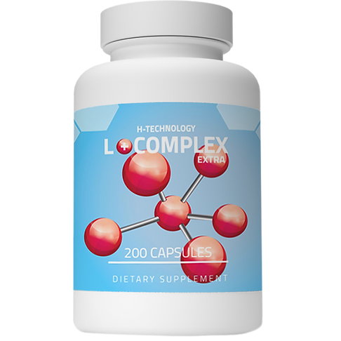
Use of natural precursors of NO (L COMPLEX) for the treatment of Covid-19 complications and in acute and chronic wounds.

Slide 2
Hospital Sokolov s.r.o. (CZ) Surgery Department Wound healing clinic
Therapies at the clinic
Patients selected
diabetic foot
leg ulcers venous etiology
ulcers due to ischemic lower limb disease
pressure ulcers of all degrees
postoperative complications
burns
different types of wounds
polymorbidity
longer treatment time in the past
COVID-19 complications

Slide 3
Guarantors of research and development Head of surgical team: Doctor Consultant Peter Šebo Head nurse of surgical team: Pavla Velická Medical director of Hospital Sokolov: Doctor Consultant Andrej Farkaš Hospital‘s pharmaceutical Consultant: Doctor Ľudmila Debnárová
Type of treatment
Patient
modern procedures for wounds healing
materials
machines (system V.A.C. – vaccuum controlled treatment)
communication and treatment‘s understanding
medication and food supplements
L COMPLEX
cooperation
nutrition and diet
treatment at home
mental well-being

Slide 4
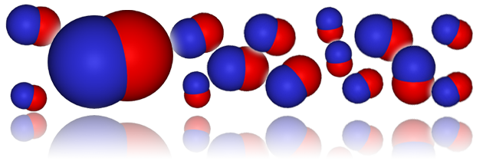
WHY L COMPLEX?
donor of molecules NO
vazodilatation
microcirculation
catalyst (starter) for enzymes in endothelial cells
prevents the formation of thrombi
donor of amino acids
granulation tissue structure

Slide 5
CASE STUDY 1
man, age 80
4th March 2021 admission to hospital for COVID-19 in the ICU
14th March worsening respiration and renal function failure
patient in sedation with tracheostomy
patient positioning, anti-decubitus mattress
formation of 2nd degree pressure ulcer, wound size 25x15 cm
Th: Inadine patch cover

Slide 6
25th March patient‘s condition improved, he was covid-negativ
patient was gradually woken up
7th April patient was transfered to the rehabilitation department
worsening of pressure ulcer – decubitus third degree
necrosis at the base of the wound
necrosis peels off the edges
the pacient‘s condition worsens – increase of CRP

Slide 7
20th April patient moved to surgical department
abscess with purulent and smelly content
necrectomy, debridement
Th: Aqvitox rinse (HClO-hypochlorous acid), to the wound Braunovidon oitment
24th April change of the treatment
Th: Flamigel, Aquacel Ag patch
bandaging every 2 days

Slide 8
30th April first use of L COMPLEX 2x3g (2x6cps)

Slide 9
the woud‘s size decreased rapidly (14.5.) – after 2 weeks using L COMPLEX
patient‘s results had dramatically improved
breaking point
the wound had parcially healed
BUT
pacient was confused, mental health declined
stoped eating
He lost the will to live.
20th May patient was discharged to home care

Slide 10
June 2021 (2 months L COMPLEX)
V.A.C. systém – change of bandages every 6 days
gradual improvement
the patient begun to eat
mental state improved
painkiller‘s dose was reduced

Slide 11
July 2021 (3 months L COMPLEX)
pressure ulcer gradually healed
wound size 13 x 10 cm
Th: Aqvitox gel + Aqvitox flowfiber
patient immobile
new decubits on the trochanters (hips) 1x1cm, necrotic
new decubits on the heels, 2x2cm, 3x3cm, necrotic
rehabilitation twice weekly

Slide 12
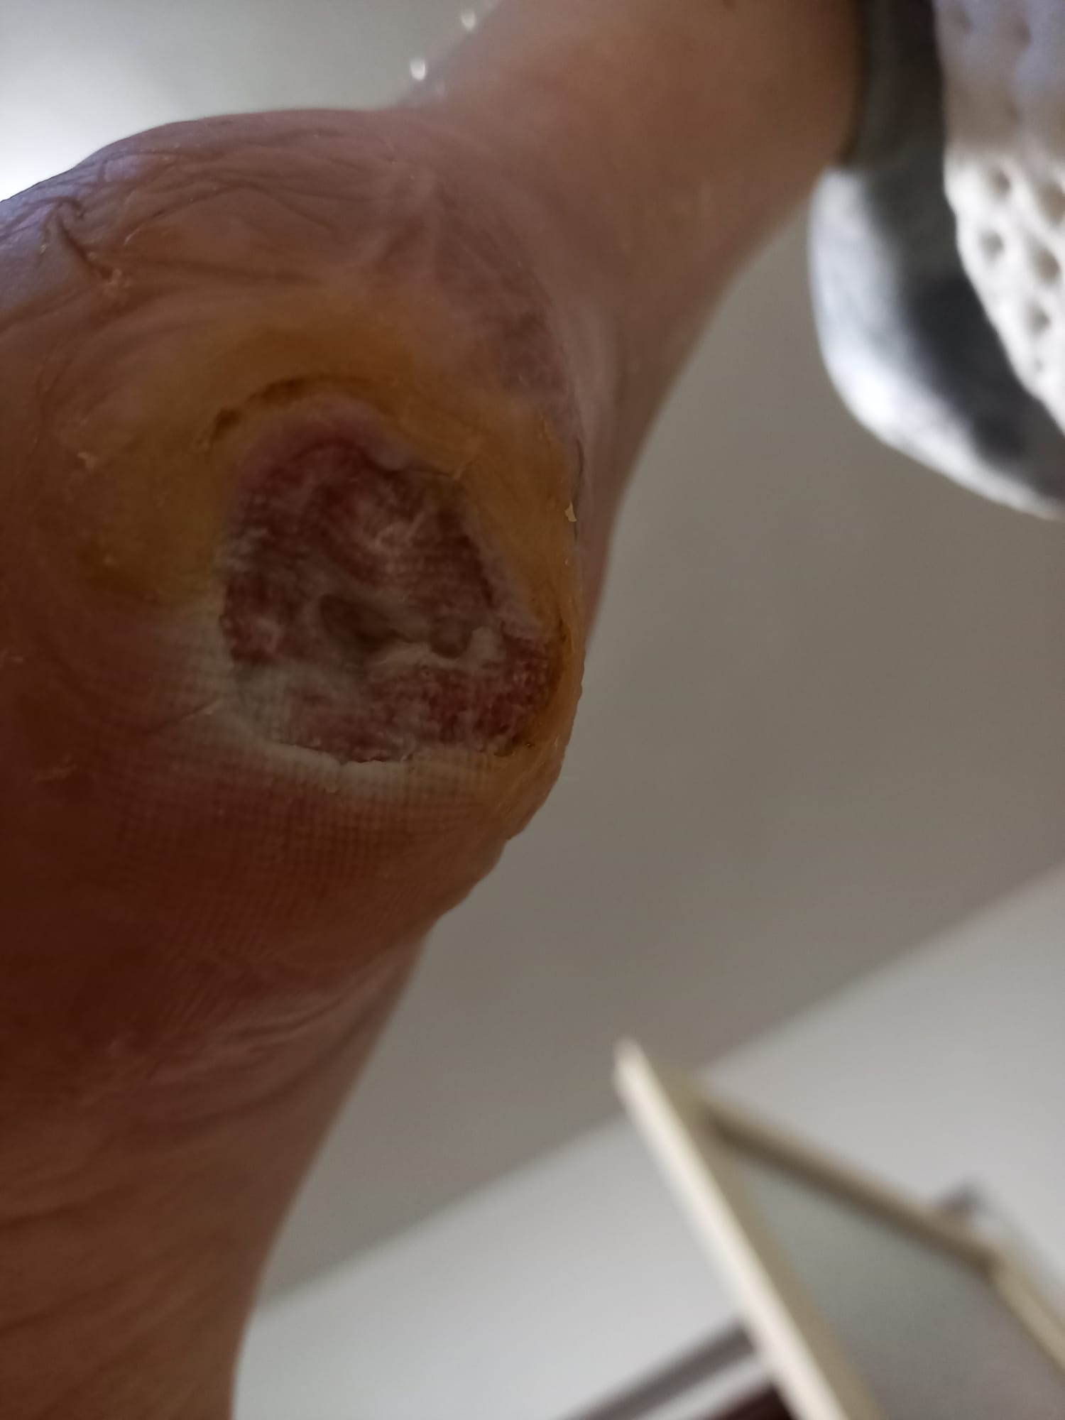
October 2021

Slide 13
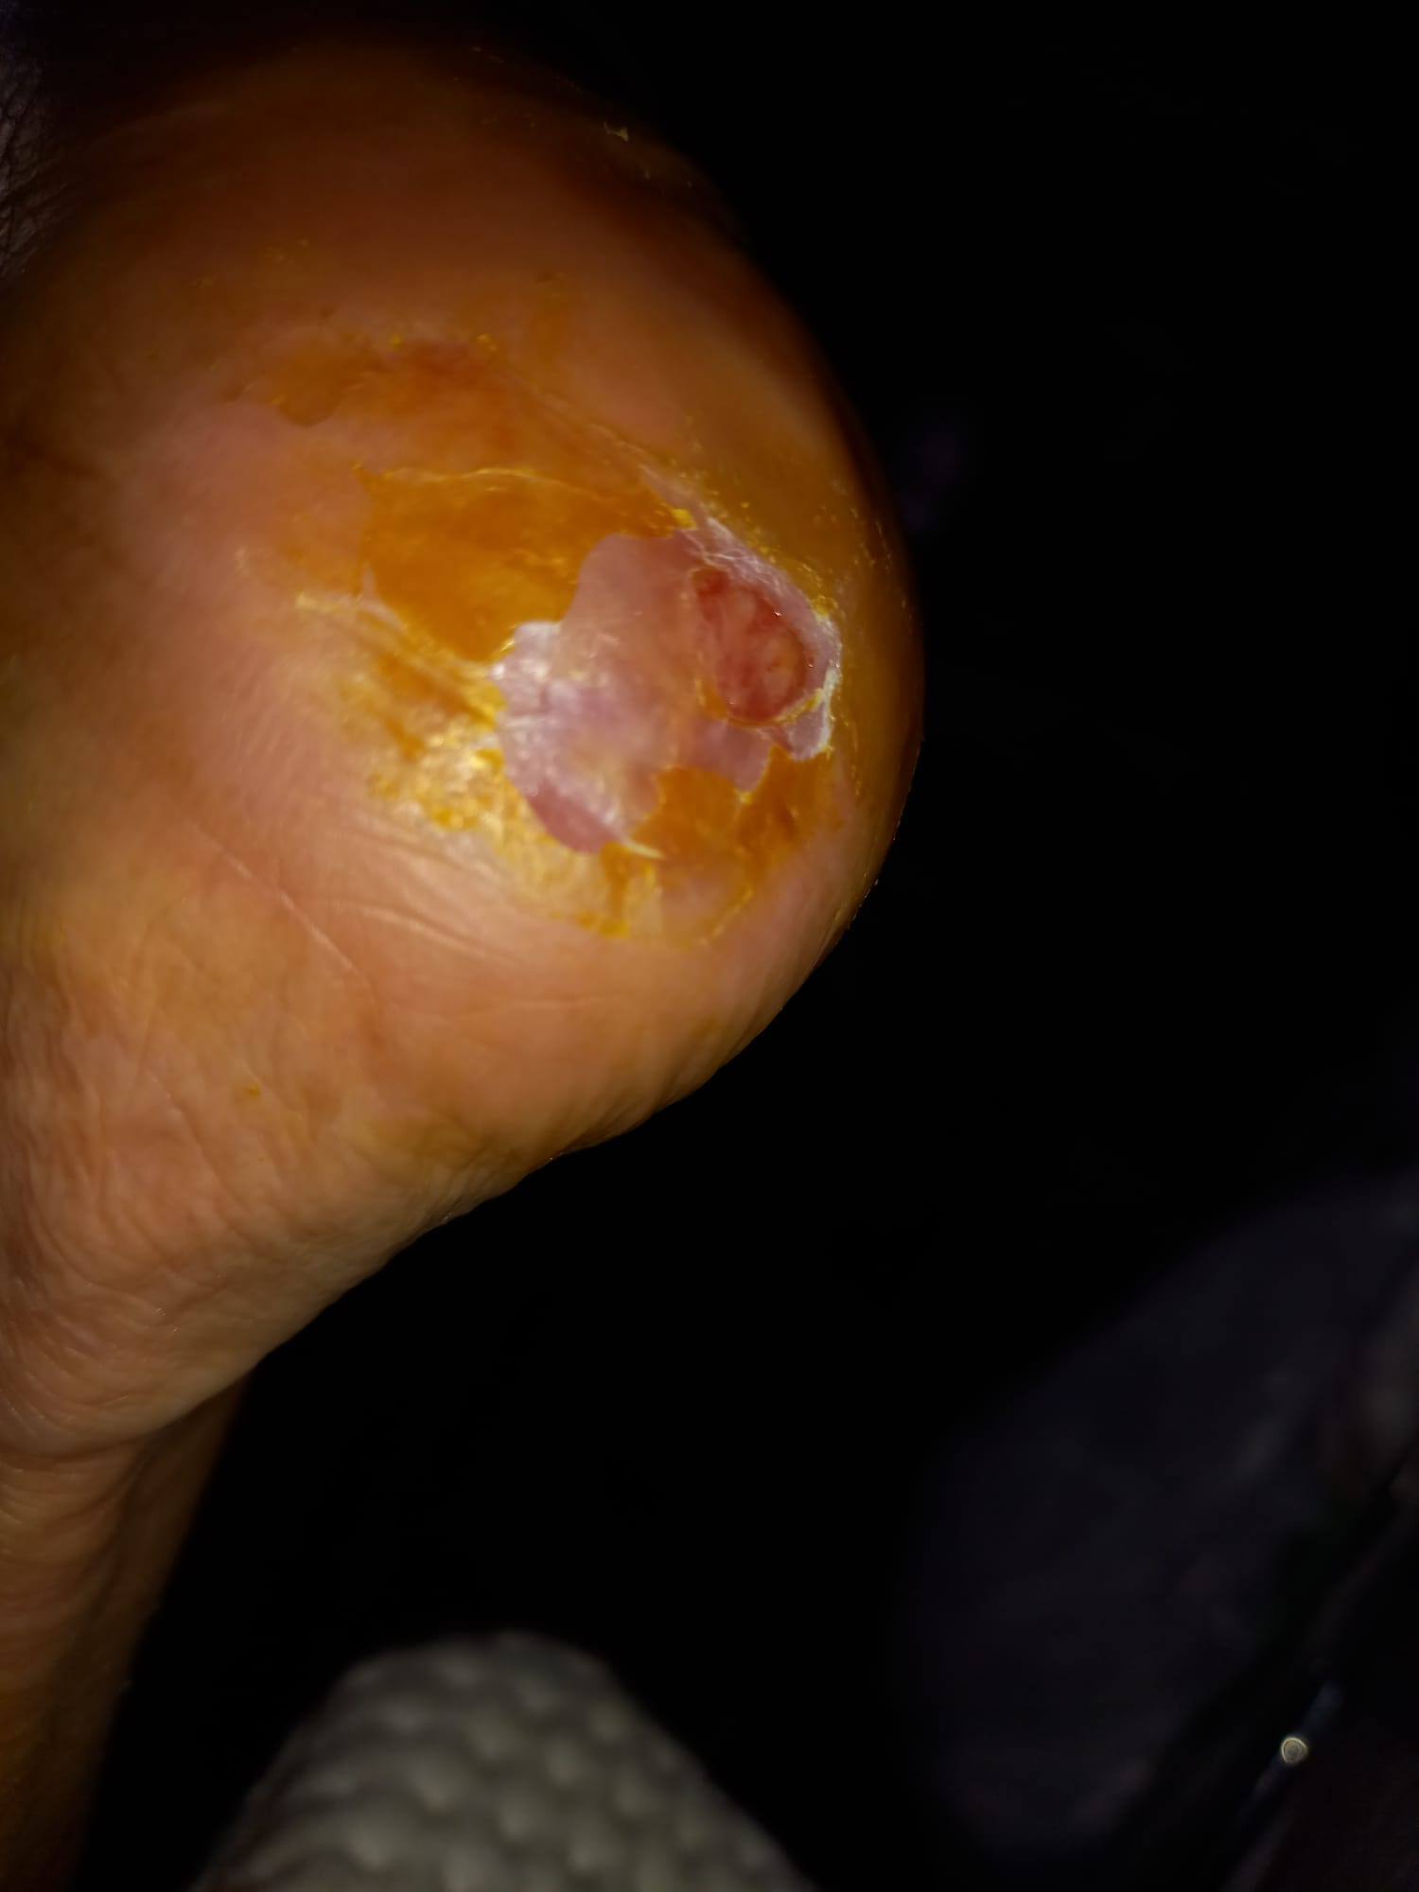
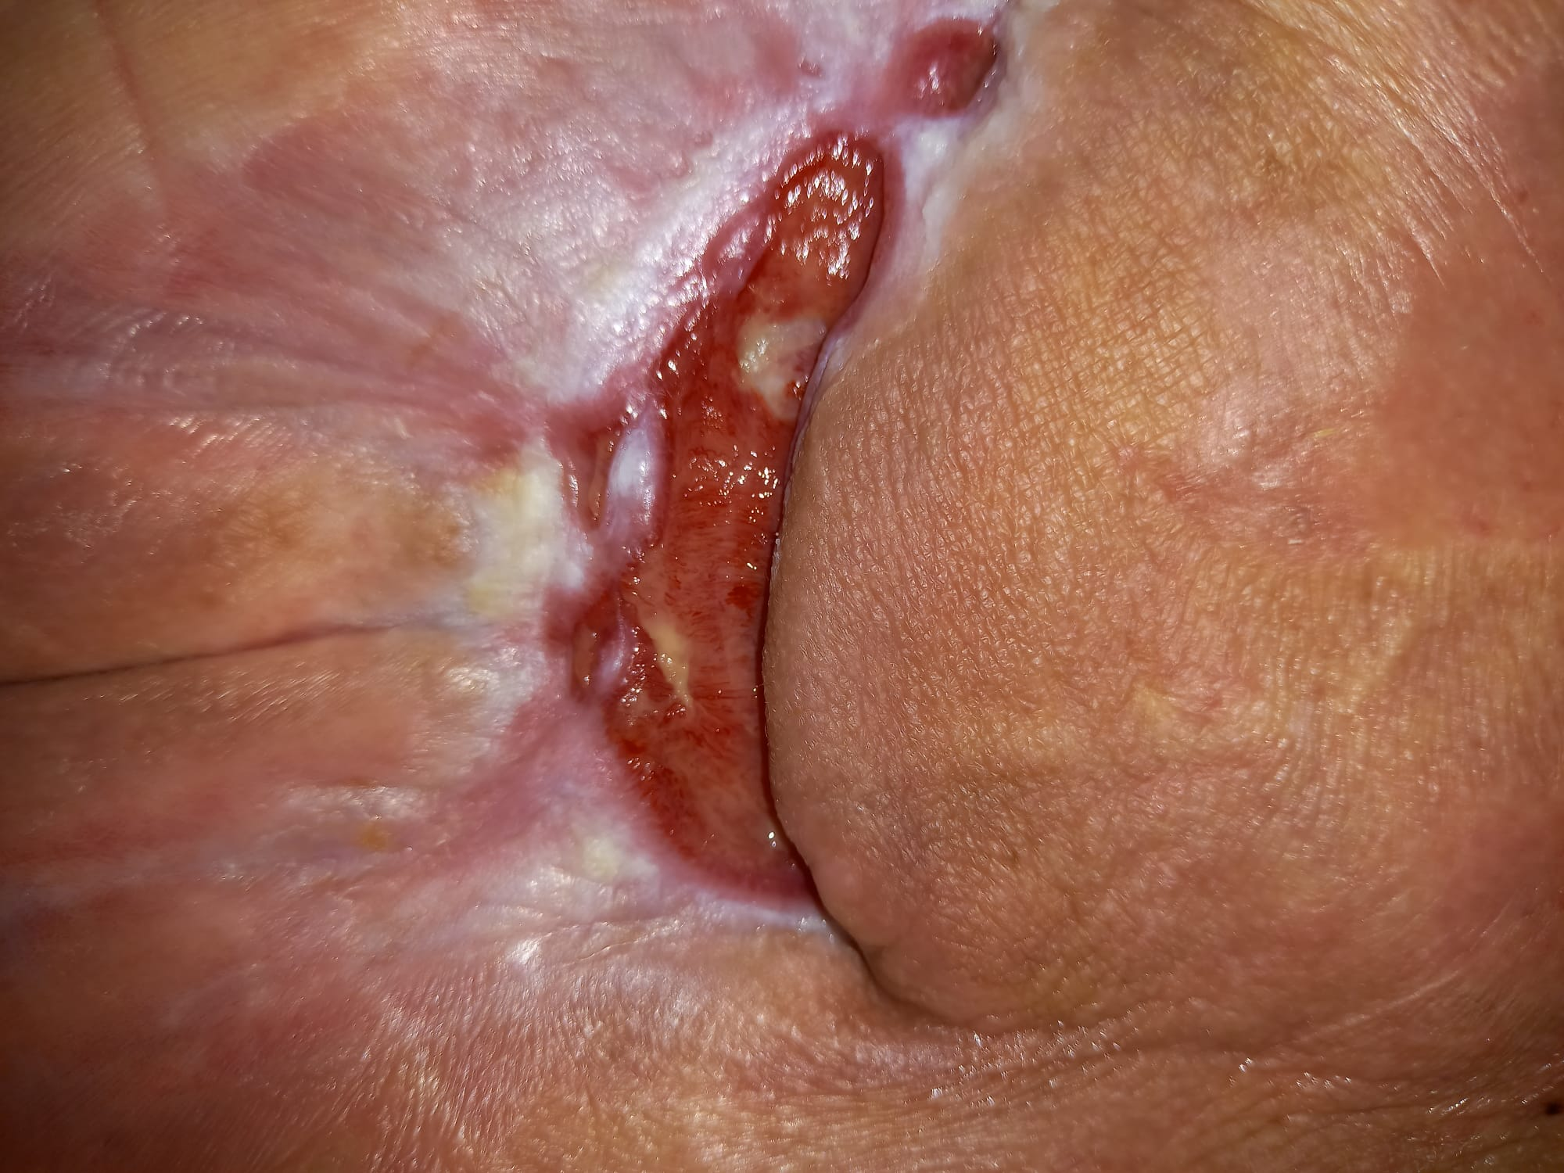
November 2021

Slide 14
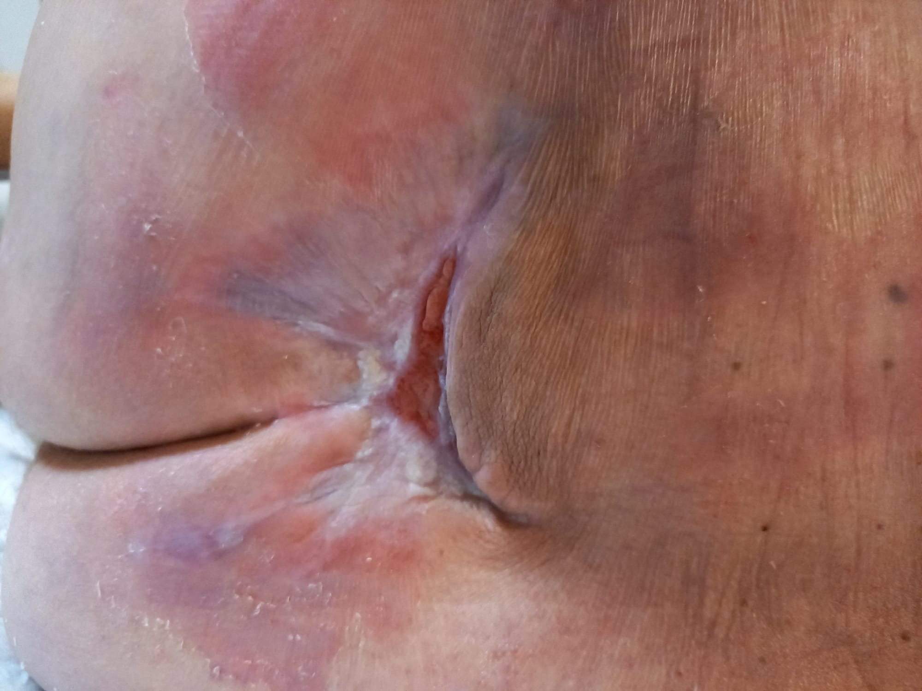
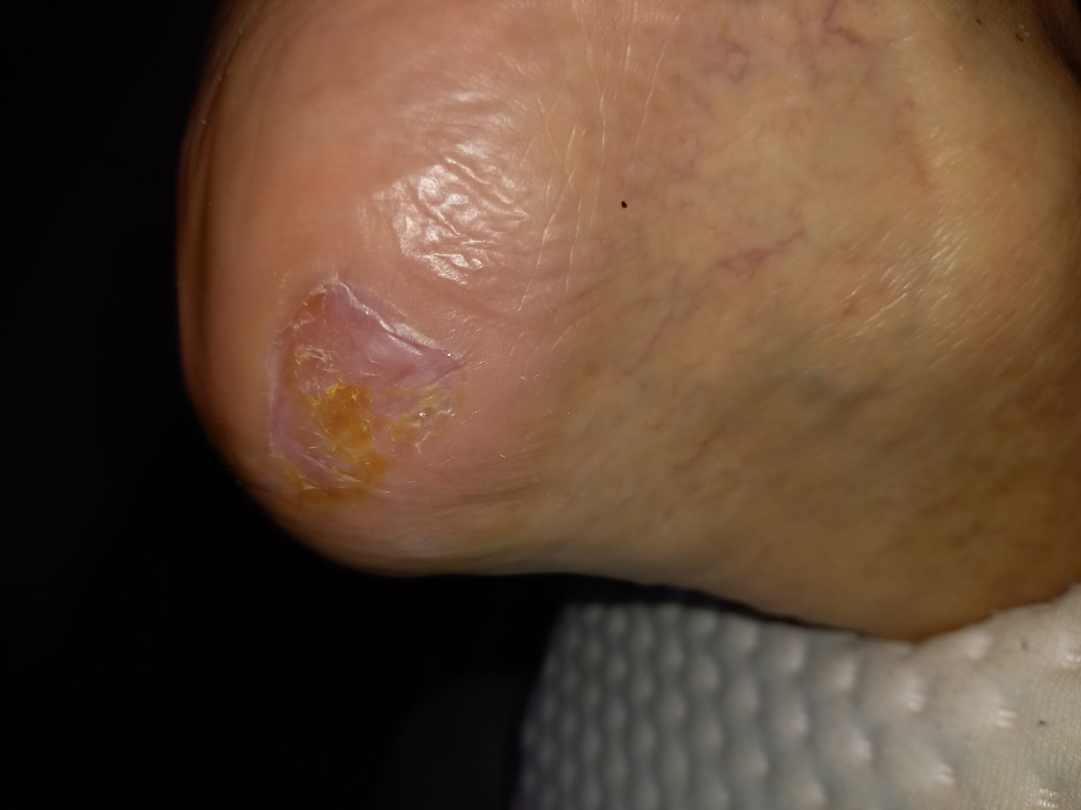
December 2021
January 2022
(after 9 months)

Slide 15
CASE STUDY 2
man, age 58
Achilles tendon injury
in the anamnesis DM on PAD
calf abscess
10th May incision + excision of the Achilles tendon
wound size 28 x 6 cm
Th: V.A.C. systém + L COMPLEX 2 x 3 g

Slide 16
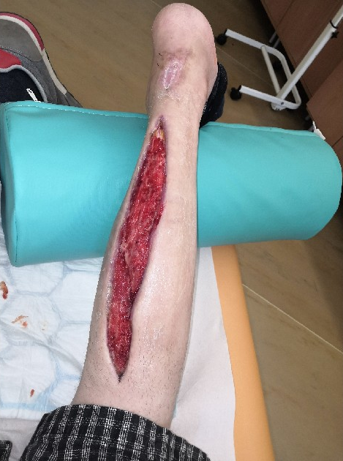
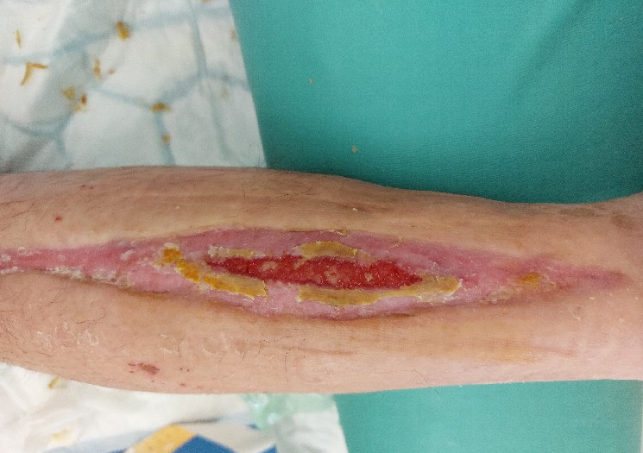
3th Jun 2021
2th September 2021 (photo)
Completely healed at the end of september after 4 months using L COMPLEX therapy.

Slide 17
CASE STUDY 3
man, age 65
posttraumatic chronic defekt from an accident in the 1970s
calf bone (fibula) removed, the leg was deformed
wound opened 9 years ago
5 years treated at Wound healig clinic
hypertension, DM on PAD
several times in the past inflammation (flegmona), necrectomy, hyperbaric chambre
The patient cooperated really well.
selected for the case study in April 2021 L COMPLEX 2 x 3 g

Slide 18
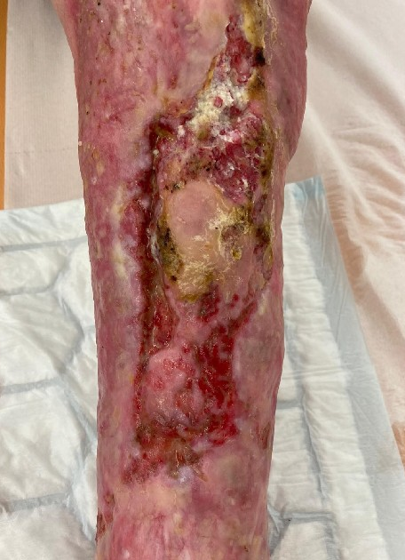
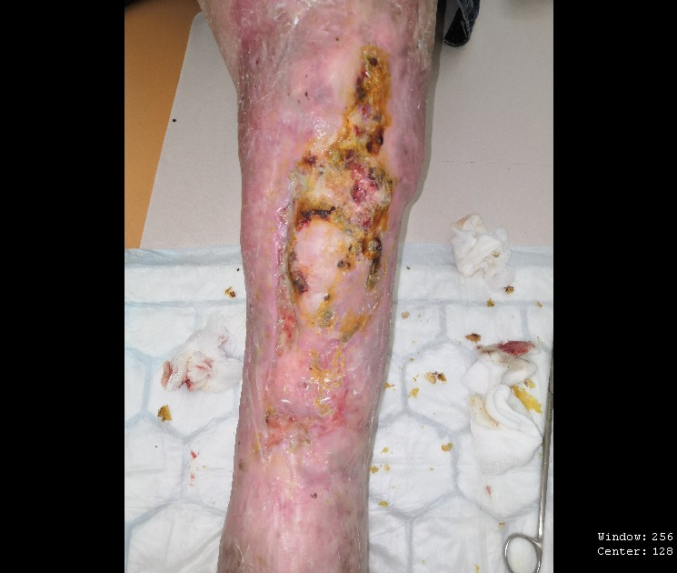
May 2021
Jun 2021 – after 4 months using L COMPLEX therapy the wound completely healed

Slide 19
CASE STUDY (16 patients)
case study lasted approximately 6 months
different types of wounds – decubits, diabetic foot, leg ulcer venous etiology
6 patients completely healed
8 pacients significantly improved
1 patient died of Covid-19
1 patient‘s condition deteriorated due to Covid-19, decompensated DM, glycemia above 12 and patient didn‘t cooperate

Slide 20
GET YOUR HEALT BACK

Slide 21
THANK YOU VERY MUCH FOR YOUR
ATTENTION.
PharmDr. Ludmila DEBNAROVA
ludmila.debnarova@nemocnicesokolov.cz

Slide 22
CASE STUDY 4
teenager age 14, hockey player, training 2 x per day 6 times a week
2012 hockey injury
Dg. Cortical defects on the femur and knee of the left leg (4 bearings size 3 – 5 cm, 2 x femoral bearing near the knee, 2 x knee bearing, all in front of the foot). Unchanged untill August 2018.
June 2018 experiencing pain when walking
July 2018 patient stoped walking
MRI – Dg. Dissecting osteochondritis of the dorsal surface of the medial condyle of the femure, size 16 x 17 mm in depth 5 mm.

Slide 23
20.August 2018 L COMPLEX 2 x 1,5 g
after 2 months of using L+COMPLEX – pain only during intensive training
December 2018 patient was finally pain free
14th January 2019 medical check up
patient completely healed

